Slide 1
Product Recommendation System for e-commerce
SOCIAL NETWORK ANALYSIS PROJECT
Team 10:
Vishnupriya N
Navvya L
Ishwarya Rani M

Slide 2
Abstract
In today's world, we find a wide variety of search options and we may have difficulty selecting what we really need. The recommendation System plays an important part in dealing with these problems. A recommender system is a framework that is a filtering system that filters the data with various algorithms and recommends the user with the most relevant data. Recommendation systems are productive customization mechanisms, often up-to-date and recommendations based on current consumer preferences. These systems have shown to be extremely helpful in different areas of e-commerce, education, movies, music, books, films, scientific papers, and various products. In this project Product Recommendation system for e-commerce is implemented. Product-recommendation system is powered by machine learning and employs suggestions of goods associated with a brand's digital assets. Driven by a range of algorithmic decisions, recommendations algorithms have a customized experience for user, product and background information. This helps people find what they want and the items they're searching for thus improving the search process. In this way, enterprises can understand more about the individual needs and desires of a customer optimize success in real time while improving their long-term research roadmaps

Slide 3
Literature Survey
Sr. No. | Paper | Methodology | Drawbacks
1. | E-commerce personalized recommendation analysis by deeply learned clustering | Customized recommendation system for e-commerce products based on the representation of learning clusters. They integrated RNN and attention mechanisms to design product recommendation systems for ecommerce(RNN with attention mechanism and KNN clustering) | Cold start problem and Sparsity problem can arise if there is no web browsing history.
2. | DeepFusion: Fusing User-Generated Content and Item Raw Content towards Personalized Product Recommendation | They developed user and product representations using numerical ratings, written reviews, and item metadata using DeepFusion, a deep neural network. They have also discussed item Metadata modeling. | Model was evaluated on the basis of a single dataset

Slide 4
3. | Machine learning based customer sentiment analysis for recommending shoppers, shops based on customers review | The collaborative filtering and product similarity methods are used in this paper to build a Hybrid recommendation system. | Data and application are defined interoperability
4. | Product Recommendation System from Users Reviews using Sentiment Analysis | By manipulating key words, their model can anticipate the product's average score. To accomplish so, they have combined a fresh new relative model with the standard approach, which is a sentiment-based prediction strategy. | They can take into account additional linguistic rules while interpreting the context. Sentiment dictionaries can be enhanced to allow for finer grained sentiment analysis.

Slide 5
5. | Product Recommendation System based on User Purchase Priority | They've devised a system that considers the user's priority while looking for and purchasing goods. The system then shows the user the findings after processing and analysis of their preferences. | Explicit feedback of user is required
6. | Product Recommendation System based on User Trustworthiness & Sentiment Analysis | ] Their suggested system collects reviews from various websites and conducts sentiment analysis and opinion mining on them. Other considerations include star ratings, buyer's profile and prior transactions, as well as whether or not the review was posted after the purchase. | Neural networks may be used to decrease over-fitting even further.

Slide 6
Our contribution
The recommendation system is designed in 3 parts based on the business context:
Recommendation system part I: Product popularity based system targeted at new customers
Recommendation system part II: Model-based collaborative filtering system based on customer's purchase history and ratings provided by other users who bought items similar items
Recommendation system part III: When a business is setting up its e-commerce website for the first time without any product rating

Slide 7
About Dataset
Dataset name: Amazon Product review dataset
This is a dataset related to over 2 Million customer reviews and ratings of products sold on their website.
It contains-
the unique UserId (Customer Identification),
the product ASIN (Amazon's unique product identification code for each product),
Ratings (ranging from 1-5 based on customer satisfaction) and
the Timestamp of the rating (in UNIX time)

Slide 8
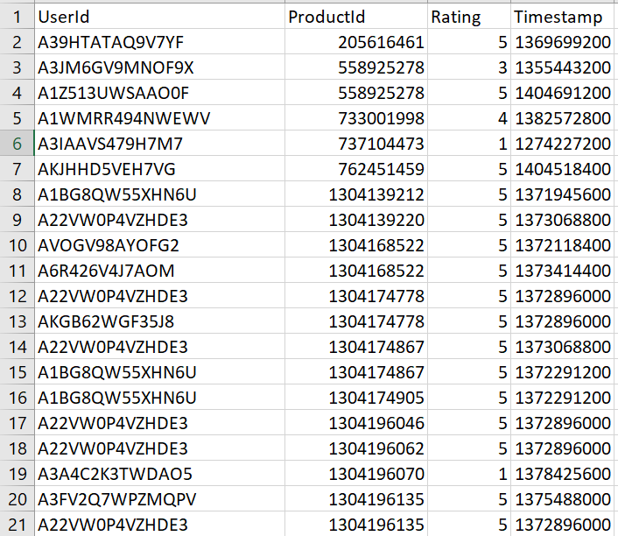

Slide 9
Dataset name: Home Depot Product Search Relevance
File descriptions
train.csv - the training set, contains products, searches, and relevance scores
test.csv - the test set, contains products and searches. You must predict the relevance for these pairs.
product_descriptions.csv - contains a text description of each product. This table can be joined to the training or test set via the product_uid.
attributes.csv - provides extended information about a subset of the products (typically representing detailed technical specifications). Not every product will have attributes.
sample_submission.csv - a file showing the correct submission format
relevance_instructions.docx - the instructions provided to human raters
The relevance is a number between 1 (not relevant) to 3 (highly relevant).
For example, a search for "AA battery" would be considered highly relevant to a pack of size AA batteries (relevance = 3), mildly relevant to a cordless drill battery (relevance = 2), and not relevant to a snow shovel (relevance = 1).

Slide 10
Data fields
id - a unique Id field which represents a (search_term, product_uid) pair
product_uid - an id for the products
product_title - the product title
product_description - the text description of the product (may contain HTML content)
search_term - the search query
relevance - the average of the relevance ratings for a given id
name - an attribute name
value - the attribute's value

Slide 11
Thank you

